Slide 1
NTC’s Auditorium Remodel Project
Presented by: Tim Dunbar
Director of Computers & Instructional Technology

Slide 2
Overview
Remodeling a 200 seat, tiered auditorium into a dividable conferencing space for up to 500 people
Technology needs
Furniture needs
Storage needs
“Wow” factor items

Slide 3
Starting point

Slide 4
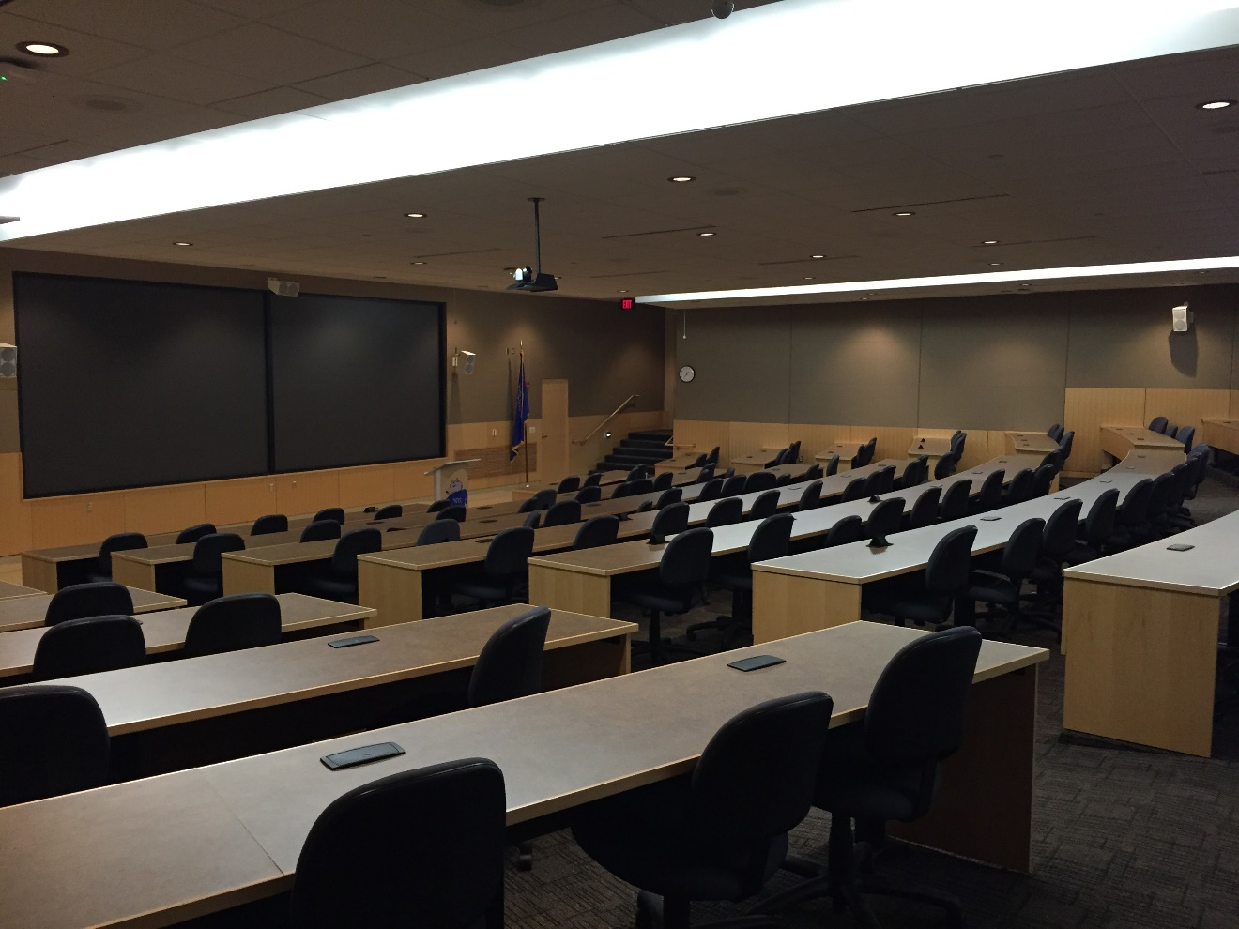

Slide 5
Initial Considerations

Slide 7
Technology needs
Display size
Dual 220” image in the main room
Dual 106” image in the secondary room
90” side displays for reinforcement
Wired and wireless presentation connectivity
Wireless microphones

Slide 8
Technology needs continued
To IVC or not to IVC, that is the question
Settled on a streaming solution
Camera type and location
Tracking technologies
Wired and wireless control system interfaces

Slide 9
Furniture needs
Instructor console?
Stage
Diversity of seating arrangements
Theater style (519)
Double square (288)
Classroom style (244)
Round (306)

Slide 10
Storage needs
Where is the presentation technology kept so it is accessible, but secure?
If there is no instructor console, where is the core technology housed?
Diversity of seating arrangements
520 chairs
122 rectangular tables
51 round tables

Slide 11
Wow factor items
Video displays that are eye catching
Can be at the cost of practicality
Unique lighting
Auxiliary projectors
Show logos

Slide 12
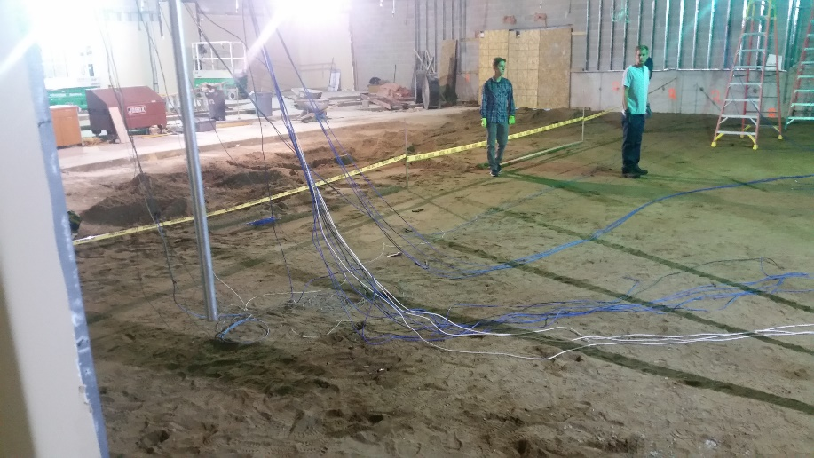
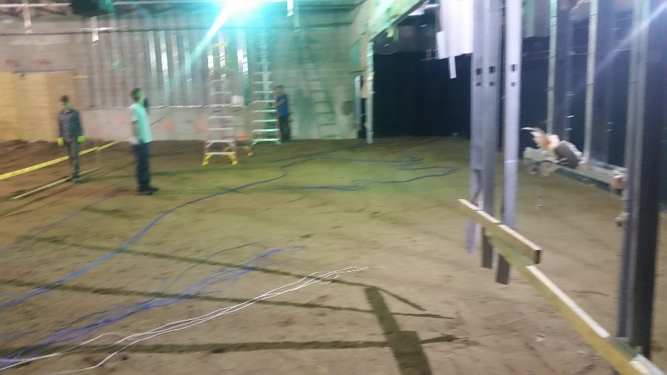
Time to get started

Slide 13
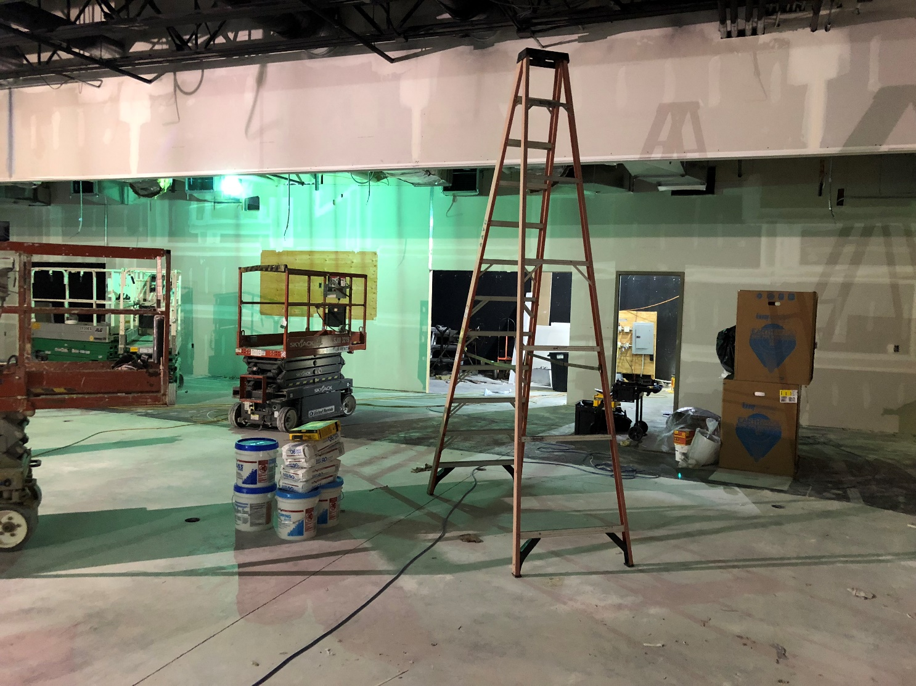

Slide 14
Major undertakings
Cutting out and removing 51 cubic yards of material
Filling in with 207 cubic yards of material
Installation of a one piece, 68’ long, 1,700lb beam to support the dividing wall panels
Replacing a classroom with a kitchenette

Slide 15
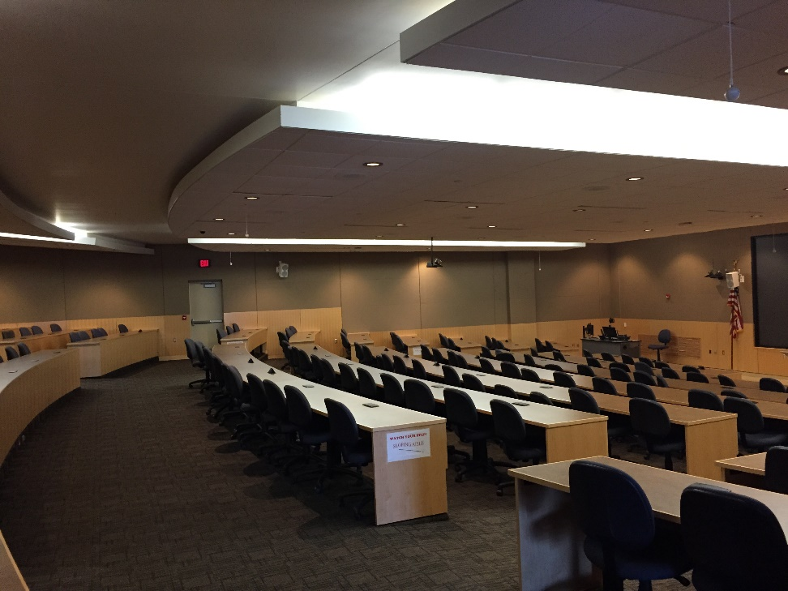
Quite the transformation
Before
After

Slide 16
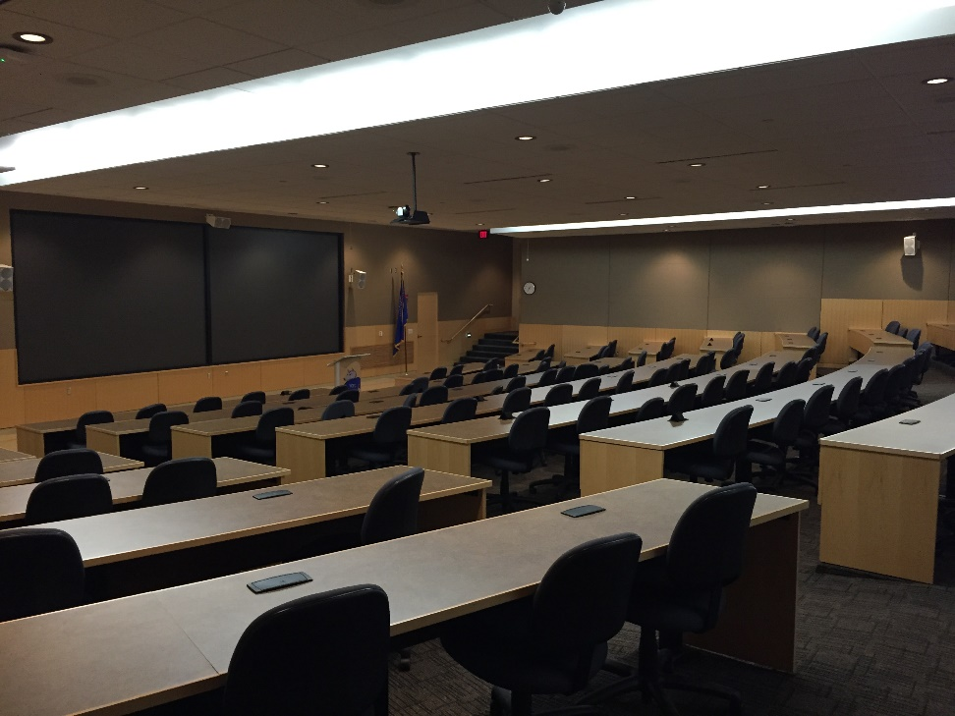
Before
After

Slide 17
Audience’s view

Slide 18
Presenter’s view

Slide 19
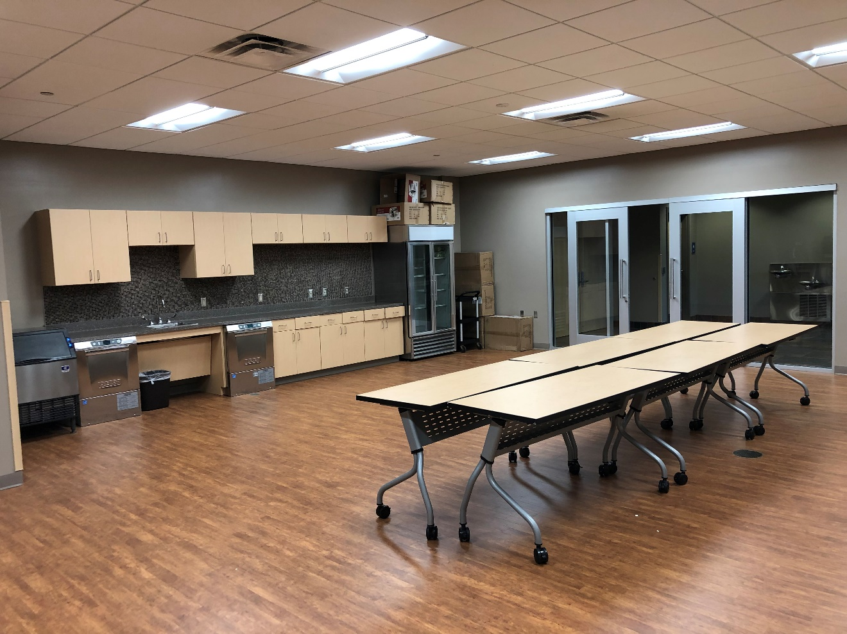
Kitchenette

Slide 20
Questions ?

Slide 21
Thank you !
Timothy A. Dunbar Director of Computers and Instructional Technology Northcentral Technical College 1000 W. Campus Dr. Wausau, WI 54401-1899 Phone: (715) 803-1116 E-mail: dunbar@ntc.edu

